Slide 1
Sensitivity Analysis

Slide 2
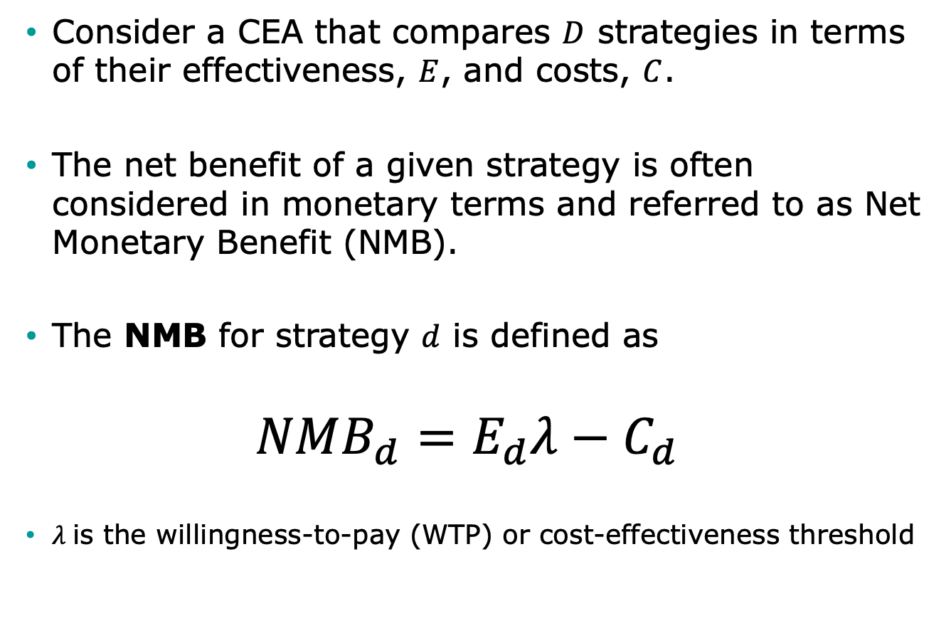
Brief note NMB in CEA
Consider a CEA that compares $D$ strategies in terms of their effectiveness, $E$, and costs, $C$.
The net benefit of a given strategy is often considered in monetary terms and referred to as Net Monetary Benefit (NMB).
The NMB for strategy $d$ is defined as
$$NMB_{d}=E_{d}λ−C_{d}$$
$λ$ is the willingness-to-pay (WTP) or cost-effectiveness threshold

Slide 3
Types of uncertainty
Term | Concept | Other terms | Model/method
Heterogeneity | Variability between patients that can be attributed to characteristics of those patients |  | Microsimulation
Summarized from: Briggs AH, Weinstein MC, Fenwick EAL, Karnon J, Sculpher MJ, Paltiel AD, ISPOR-SMDM Modeling Good Research Practices Task Force. Model parameter estimation and uncertainty analysis: a report of the ISPOR-SMDM Modeling Good Research Practices Task Force Working Group-6. Med Decis Making. 2012; 32(5):722–732.

Slide 4
Types of uncertainty
Term | Concept | Other terms | Model/method
Heterogeneity | Variability between patients that can be attributed to characteristics of those patients |  | Microsimulation
Stochastic uncertainty | Random variability in outcomes between identical patients | Monte Carlo error/ first-order uncertainty | Microsimulation
Summarized from: Briggs AH, Weinstein MC, Fenwick EAL, Karnon J, Sculpher MJ, Paltiel AD, ISPOR-SMDM Modeling Good Research Practices Task Force. Model parameter estimation and uncertainty analysis: a report of the ISPOR-SMDM Modeling Good Research Practices Task Force Working Group-6. Med Decis Making. 2012; 32(5):722–732.

Slide 5
Types of uncertainty
Term | Concept | Other terms | Model/method
Heterogeneity | Variability between patients that can be attributed to characteristics of those patients |  | Microsimulation
Stochastic uncertainty | Random variability in outcomes between identical patients | Monte Carlo error/ first-order uncertainty | Microsimulation
Parameter uncertainty | The uncertainty in estimation of the parameter of interest | Second-order uncertainty | All models / Sensitivity analysis
Summarized from: Briggs AH, Weinstein MC, Fenwick EAL, Karnon J, Sculpher MJ, Paltiel AD, ISPOR-SMDM Modeling Good Research Practices Task Force. Model parameter estimation and uncertainty analysis: a report of the ISPOR-SMDM Modeling Good Research Practices Task Force Working Group-6. Med Decis Making. 2012; 32(5):722–732.

Slide 6
Types of uncertainty
Term | Concept | Other terms | Model/method
Heterogeneity | Variability between patients that can be attributed to characteristics of those patients |  | Microsimulation
Stochastic uncertainty | Random variability in outcomes between identical patients | Monte Carlo error/ first-order uncertainty | Microsimulation
Parameter uncertainty | The uncertainty in estimation of the parameter of interest | Second-order uncertainty | All models / Sensitivity analysis
Structural uncertainty | The assumptions inherent in the decision model | Model uncertainty | All models
Summarized from: Briggs AH, Weinstein MC, Fenwick EAL, Karnon J, Sculpher MJ, Paltiel AD, ISPOR-SMDM Modeling Good Research Practices Task Force. Model parameter estimation and uncertainty analysis: a report of the ISPOR-SMDM Modeling Good Research Practices Task Force Working Group-6. Med Decis Making. 2012; 32(5):722–732.

Slide 7
Types of uncertainty
Term | Concept | Other terms | Model/method
Heterogeneity | Variability between patients that can be attributed to characteristics of those patients |  | Microsimulation
Stochastic uncertainty | Random variability in outcomes between identical patients | Monte Carlo error/ first-order uncertainty | Microsimulation
Parameter uncertainty | The uncertainty in estimation of the parameter of interest | Second-order uncertainty | All models / Sensitivity analysis
Structural uncertainty | The assumptions inherent in the decision model | Model uncertainty | All models
Summarized from: Briggs AH, Weinstein MC, Fenwick EAL, Karnon J, Sculpher MJ, Paltiel AD, ISPOR-SMDM Modeling Good Research Practices Task Force. Model parameter estimation and uncertainty analysis: a report of the ISPOR-SMDM Modeling Good Research Practices Task Force Working Group-6. Med Decis Making. 2012; 32(5):722–732.

Slide 8
Parameter Uncertainty
We have imperfect data about the input parameters and are therefore uncertain about the true parameter value
Accounts for the likelihood of the values of each of the inputs and their effect on the model outputs
We use distributions of inputs to reflect current knowledge on the parameters

Slide 9

Distributions
Distribution | Parameter modeled | Form | Comment
Uniform | Any | Range low-high | All values are equally likely. Uninformative distribution
Triangular | Any | Minimum, maximum, likeliest
Beta | Probability Quality of life weights (utility) | Beta (r,n): r = number of events and n = number of patients. For observed mean 𝜇 and standard error: | Bounded between 0 and 1
Dirichlet | Probability in the context of multiple events |  | Extension of the beta distribution, for multiple events
Hunink MGM, Weinstein MC, Wittenberg E, Drummond MF, Pliskin JS, Wong JB, Glasziou PP. Decision Making in Health and Medicine: Integrating Evidence and Values. Cambridge University Press, Cambridge, UK, 2014. ISBN 978-1-107-69047-9. Table 12.2, page 371
Notes:
Commonly used distribution to model parameter uncertainty

Slide 10

Distributions (2)
Distribution | Parameter modeled | Form | Comment
Lognormal | Rate Relative risk Hazard rate ratio Odds ratio Costs | ln(parameter) has a normal distribution with mean and standard error | Values >0, positively skewed
Gamma | Resource use Costs | Gamma (𝛼,𝛽) For observed mean 𝜇 and standard error s: | Values >0, positively skewed
Truncated |  |  | Restricting the domain of some other probability distribution
Histogram | Any | non-parametric | Based on trial data: observed relative frequency per value or per interval
Bootstrap | Any | non-parametric | Based on trial data: simulated relative frequency per value
Notes:
Hunink MGM, Weinstein MC, Wittenberg E, Drummond MF, Pliskin JS, Wong JB, Glasziou PP. Decision Making in Health and Medicine: Integrating Evidence and Values. Cambridge University Press, Cambridge, UK, 2014. ISBN 978-1-107-69047-9. Table 12.2, page 371

Slide 11
Sensitivity Analysis
Vary input parameters within plausible ranges
For which values is each strategy optimal?
Deterministic sensitivity analysis (DSA)
  One-way analysis: vary one parameter, hold rest fixed
  Two-way analysis: vary two parameters, hold rest fixed
Probabilistic sensitivity analysis (PSA)
  Simultaneously vary input parameters by randomly sampling from appropriate probability distributions
  How often is each alternative cost-effective?
  What strategy has the highest expected net benefit

Slide 12
Deterministic Sensitivity Analysis

Slide 13
One-Way Sensitivity Analysis
Systematically vary one single parameter over range of values, keeping all others fixed
p_PCed = 30%; = 40%; = 50%, etc…
For each value of the parameter, calculate the expected outcomes under each strategy
Identify which strategy is preferred for each parameter value

Slide 14
One-Way Sensitivity Analysis
Probability of early detection (Primary care) | Deaths per 1,000
 | EV ‘Do Nothing’ | EV ‘Spray’ | EV ‘Test’
30% | 0.33 | 1.05 | 0.37
35% | 0.67 | 1.10 | 0.53
40% | 1.00 | 1.15 | 0.70
45% | 1.33 | 1.20 | 0.87
50% | 1.67 | 1.25 | 1.03
55% | 2.00 | 1.30 | 1.20
60% | 2.33 | 1.35 | 1.37
65% | 2.67 | 1.40 | 1.53

Slide 15
One-Way Sensitivity Analysis
Probability of early detection (Primary care) | Life Expectancy
 | Routine practice | Primary Care | Hospital Care
30% | 3.1 | 2.8 | 3.7
35% | 3.1 | 3.1 | 3.7
40% | 3.1 | 3.4 | 3.7
45% | 3.1 | 3.7 | 3.7
50% | 3.1 | 4.0 | 3.7
55% | 3.1 | 4.3 | 3.7
60% | 3.1 | 4.6 | 3.7
65% | 3.1 | 4.9 | 3.7

Slide 16
One-Way Sensitivity Analysis
Probability of early detection (Primary care) | Life Expectancy
 | Routine practice | Primary Care | Hospital Care
30% | 3.1 | 2.8 | 3.7
35% | 3.1 | 3.1 | 3.7
40% | 3.1 | 3.4 | 3.7
45% | 3.1 | 3.7 | 3.7
50% | 3.1 | 4.0 | 3.7
55% | 3.1 | 4.3 | 3.7
60% | 3.1 | 4.6 | 3.7
65% | 3.1 | 4.9 | 3.7

Slide 17
One-Way Sensitivity Analysis
Systematically vary a single parameter over range of uncertainty, keeping all others fixed
    p_PCed = 30%; = 40%; = 50%, etc…
For each parameter value, calculate the expected outcomes under each strategy
Identify which strategy is preferred
‘Hospital Care’
‘Primary care’
30%
65%
Probability of
early detection
= Base case

Slide 18
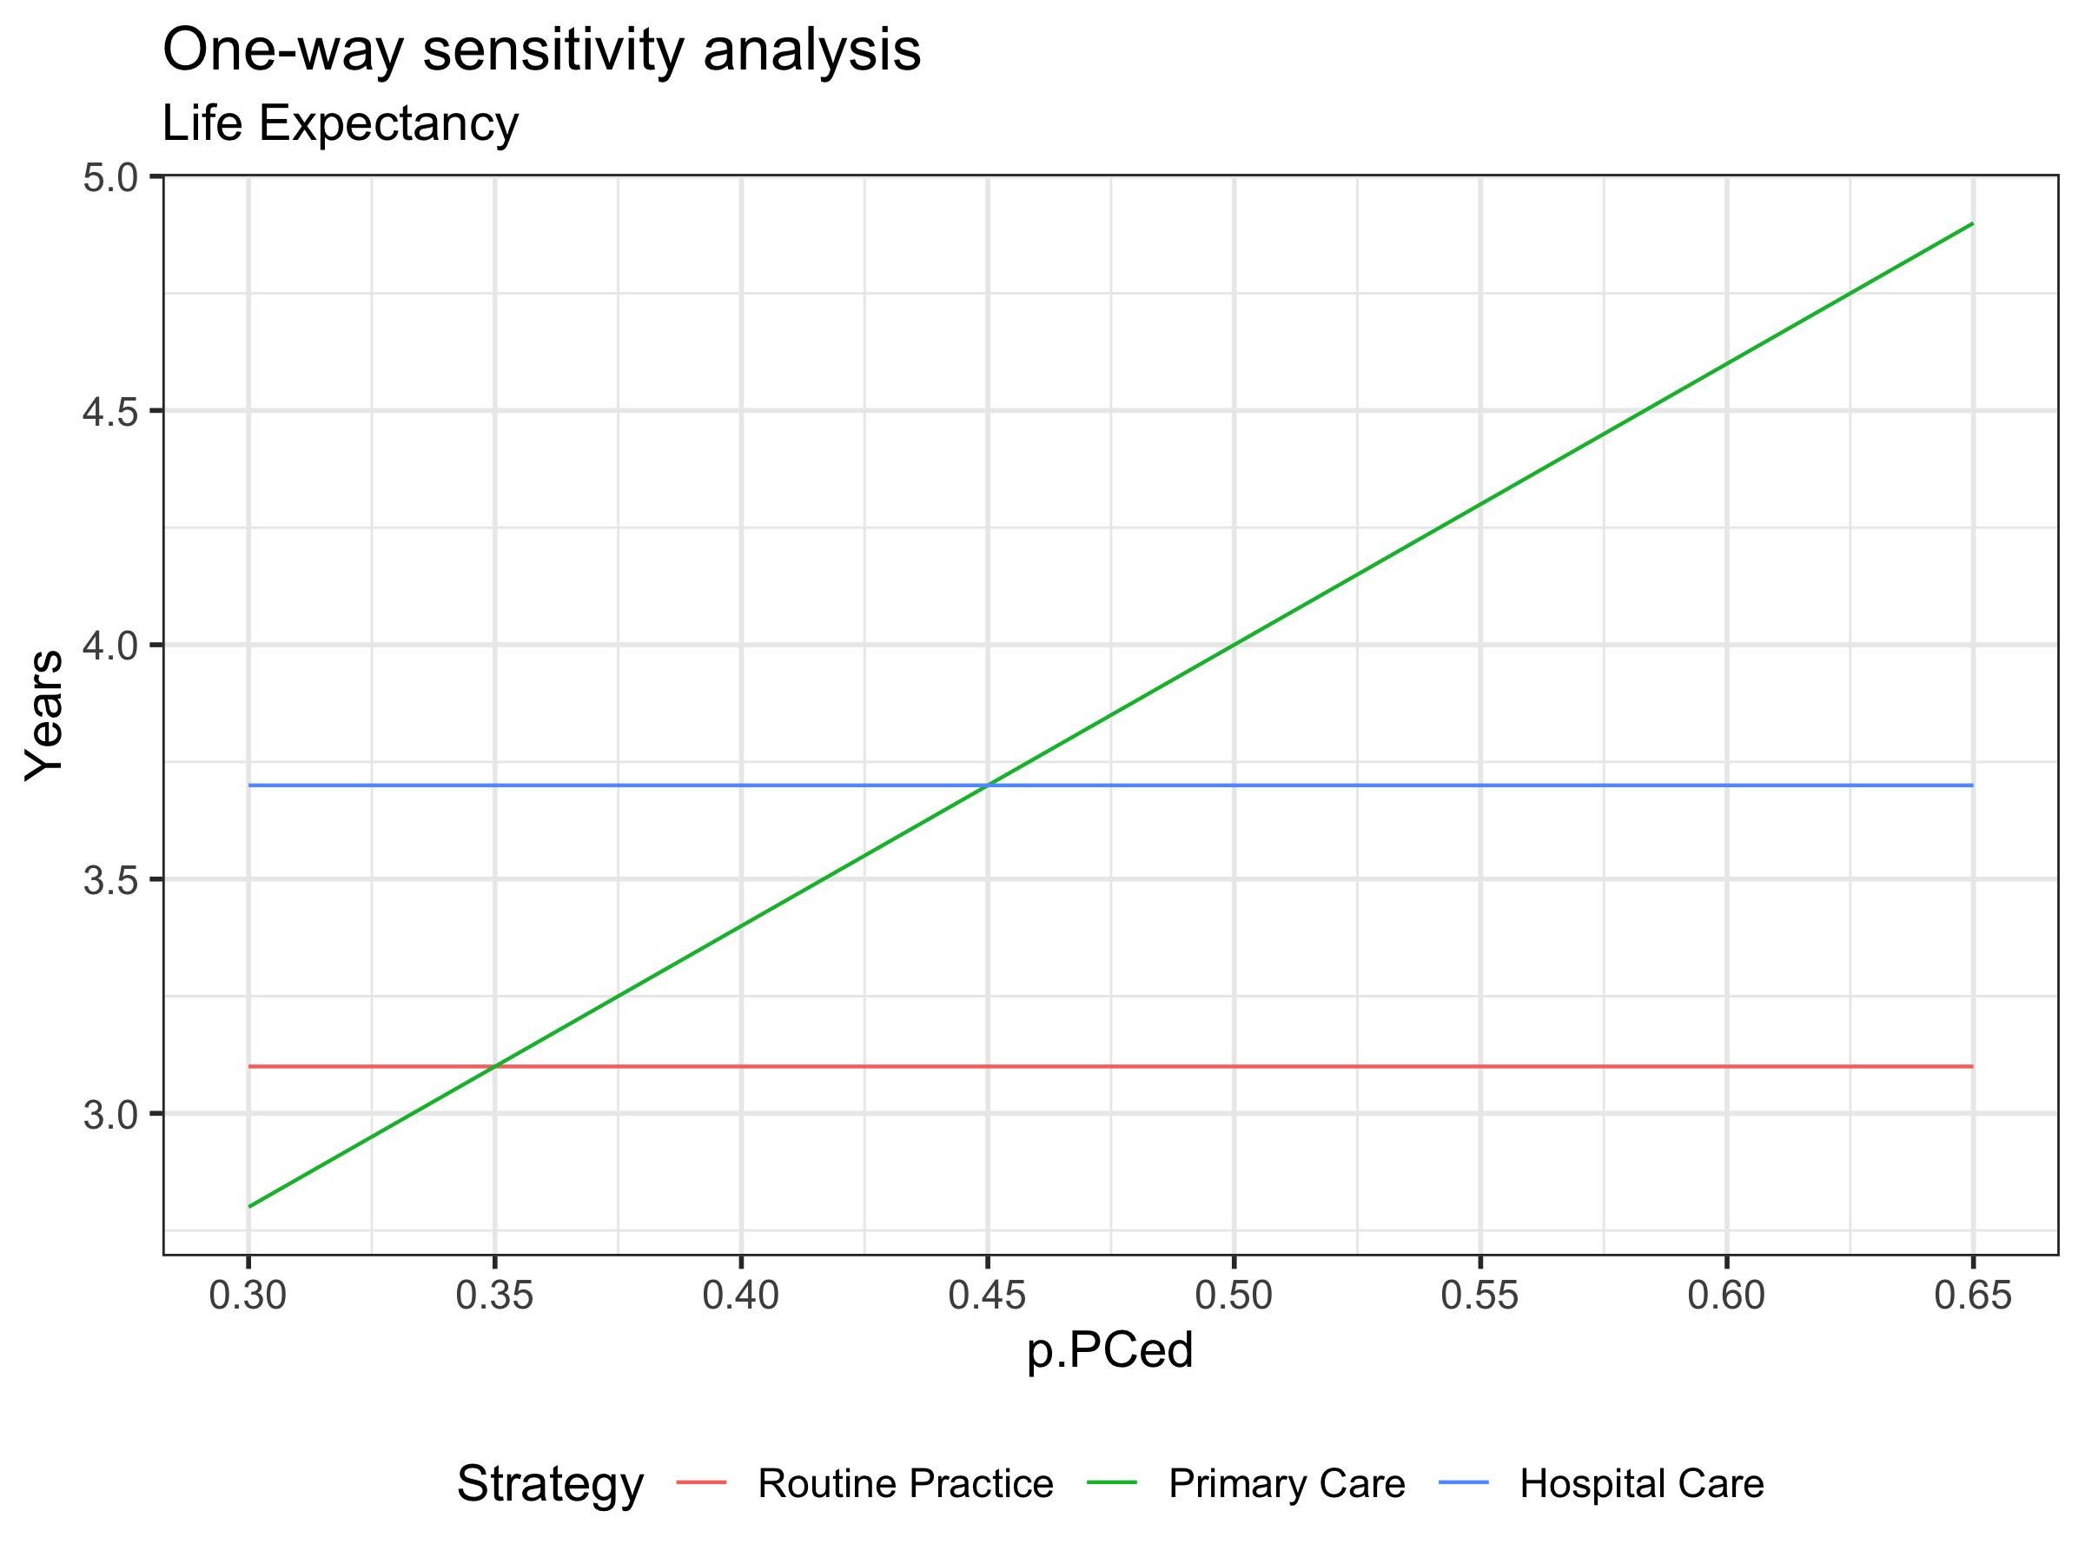
One-Way Sensitivity Analysis

Slide 19
Two-Way Sensitivity Analysis
Systematically vary two parameters over range of uncertainty, keeping all others fixed
p_PCed = 25%, p_HCed = 30%
p_PCed = 25%, p_HCed = 40%
p_PCed = 25%, p_HCed = 50%
p_PCed = 30%, p_HCed = 30%
p_PCed = 30%, p_HCed = 40%
etc…
Particularly useful if one parameter influences the impact of the other on the optimal decision

Slide 20
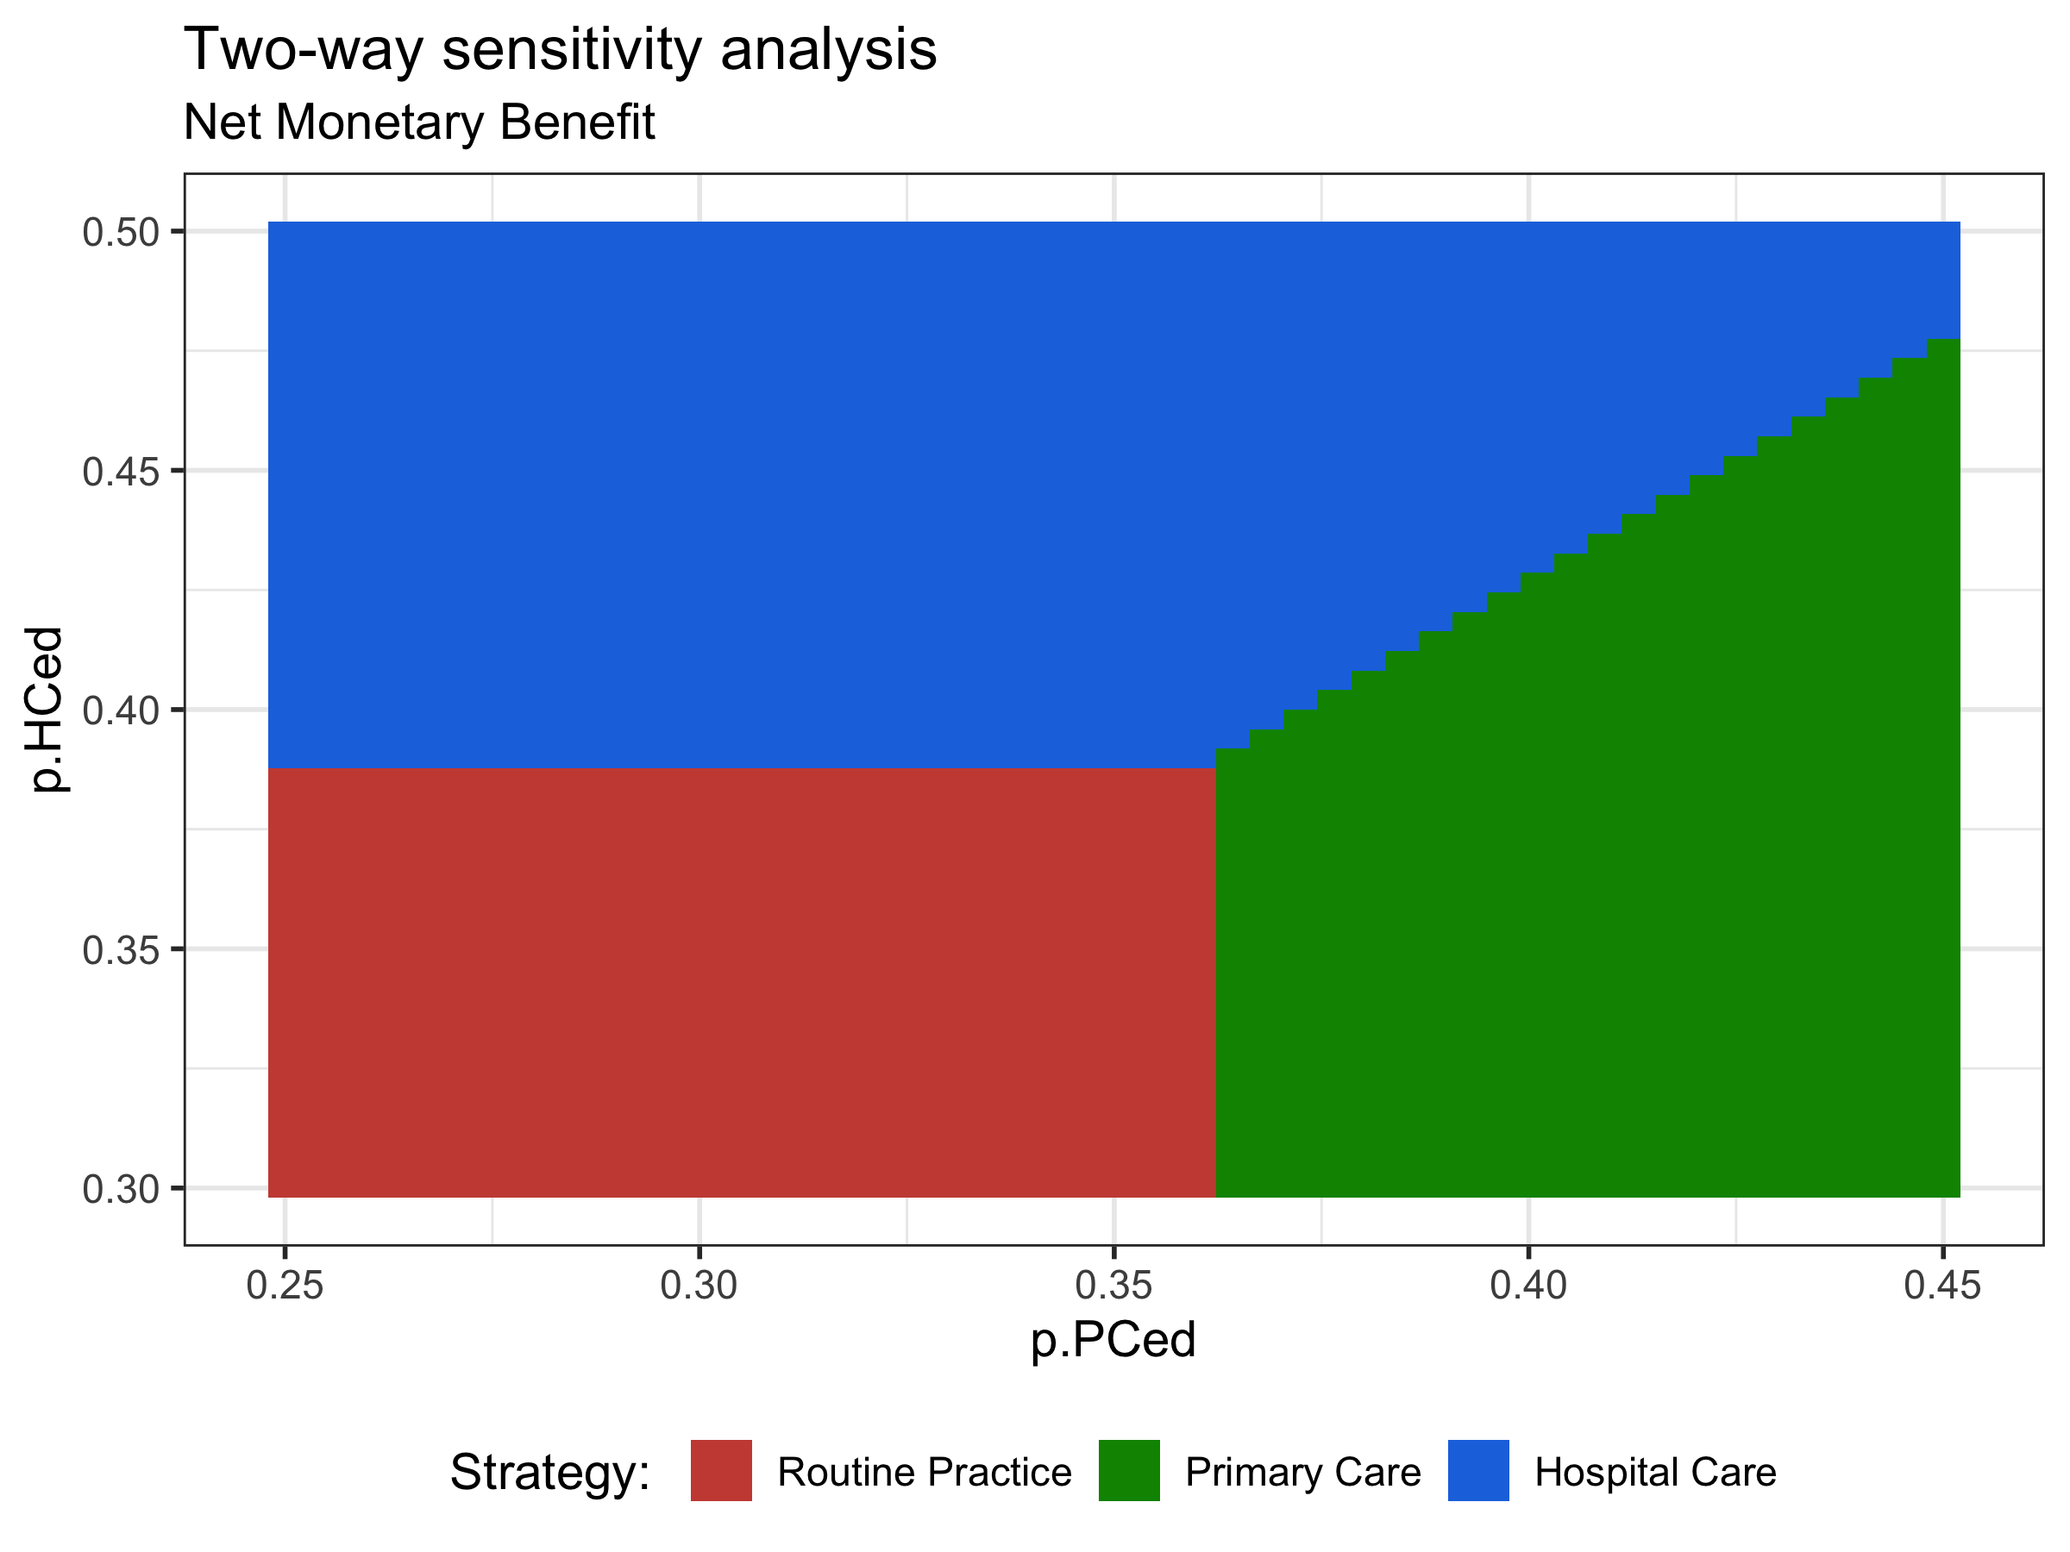
Two-Way Sensitivity Analysis

Slide 21
Probabilistic Sensitivity Analysis (PSA)

Slide 22
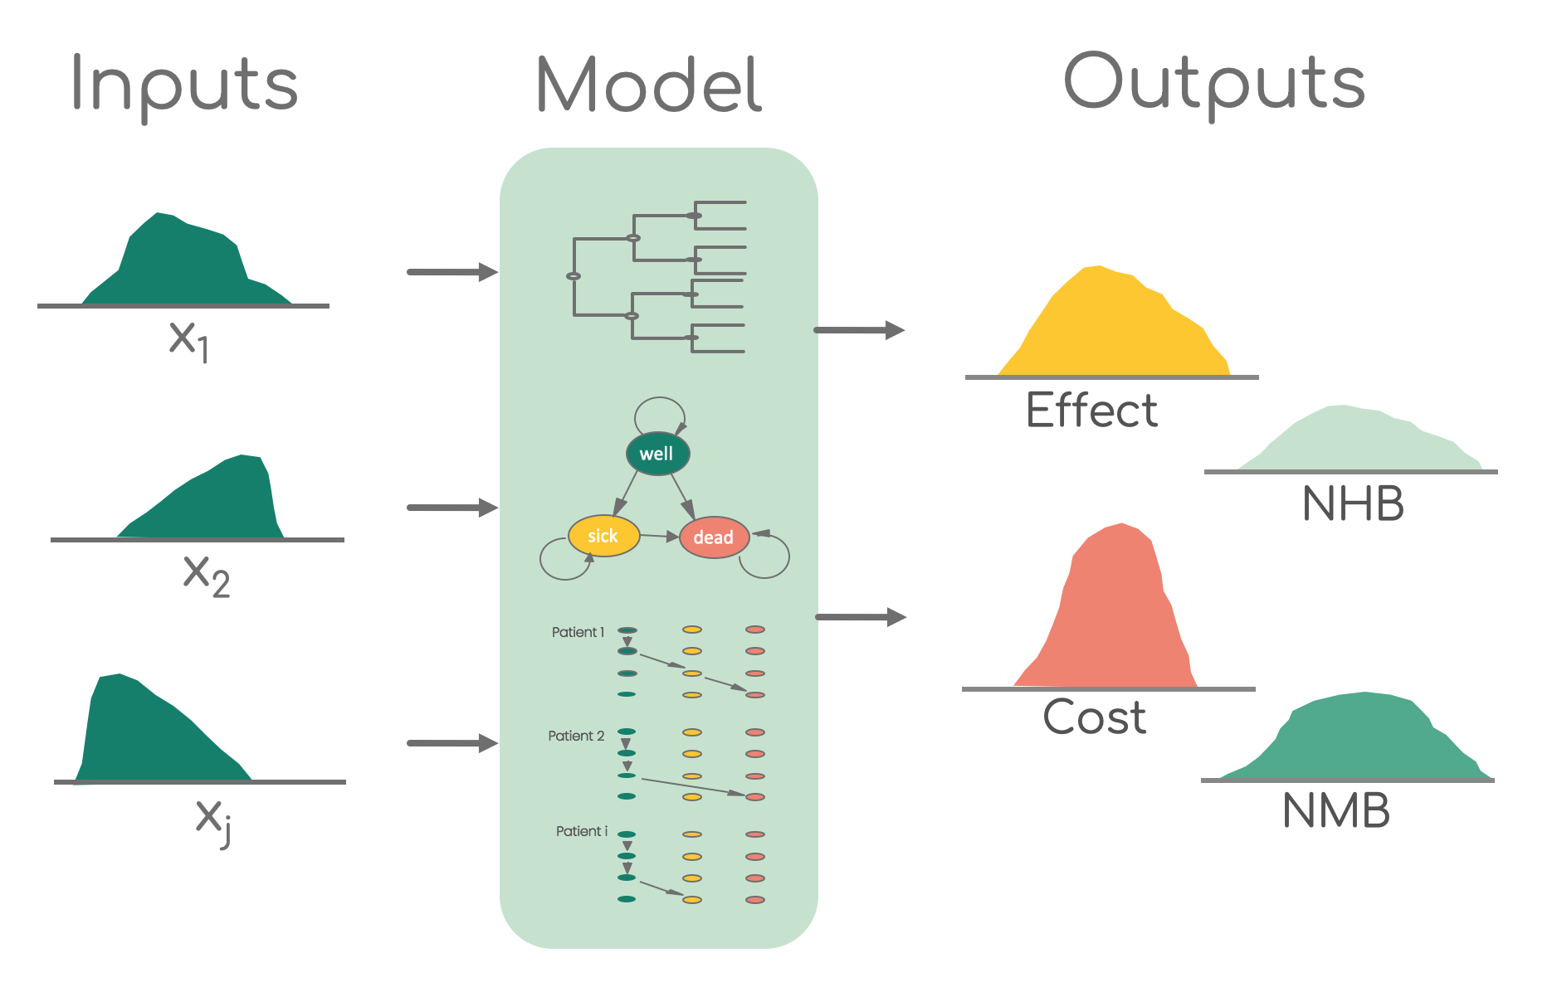
Probabilistic Sensitivity Analysis
NHB: Net health benefit ; NMB: Net monetary benefit

Slide 23
Probabilistic Sensitivity Analysis (PSA)
p_HS
Healthy (H)
Sick (S)
p_HD
p_SD
Dead (D)

Slide 24
Probabilistic Sensitivity Analysis (PSA)
p_HS
Healthy (H)
Sick (S)
p_HD
p_SD
Dead (D)

Slide 25
Remember!
Transition Matrix Calculations
Transition probabilities as a matrix
Calculated cohort distribution
To:
 | Healthy | Sick | Dead
Healthy | 0.75 | 0.20 | 0.05
Sick | 0 | 0.85 | 0.15
Dead | 0 | 0 | 1.0
From:
= P
P
x₁
x₀
0.75
0.20
0.05
0.75
0.20
0.05
=
1.0
0.0
0.0
0
0.85
0.15
0
0
1.0

Slide 26
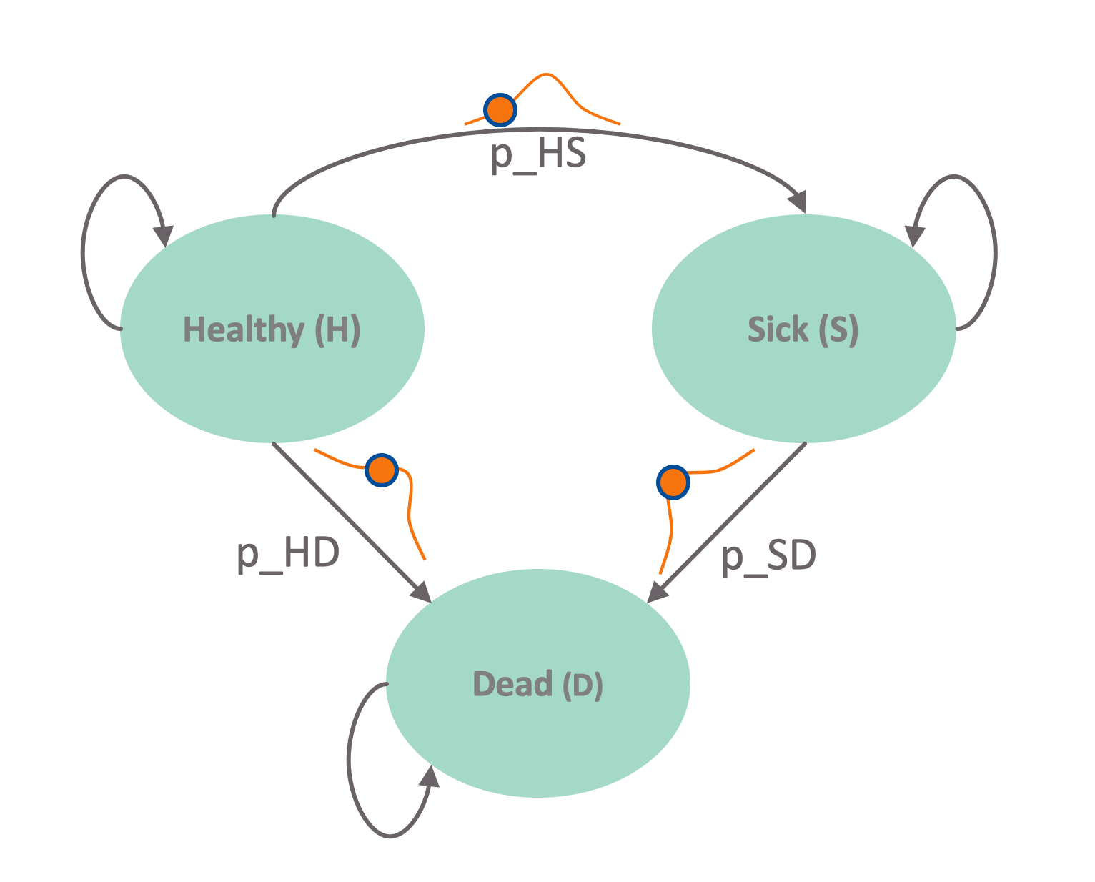
Update matrix structures for PSA iteration
Transition probability matrix P
To:
 | Healthy | Sick | Dead
Healthy | 1 – p_HS – p_HD | p_HS | p_HD
Sick | 0 | 1 – p_SD | p_SD
Dead | 0 | 0 | 1
P₁ =
From:
Indicate P is not time dependent = 1 means first PSA iteration
26
Notes:
Who is familiar with basic matrix calculations?
-> Inner product

Slide 27
Update matrix structures for PSA iteration (2)
Markov Trace M
 | Healthy | Sick | Dead
Cycle 0 | 1 | 0 | 0
Cycle 1 | 0.97 | 0.02 | 0.01
⋮ | ⋮ | ⋮ | ⋮
Cycle n | 0 | 0 | 1.0
M₁ =
Vector of cycle’s cost/outcomes
c_{H}
c_{s}
0
e_{H}
e_{s}
0
c₁ =
e₁ =
27
Notes:
Who is familiar with basic matrix calculations?
-> Inner product

Slide 28

Calculating total costs & effects
Total effects (TE):
Total costs (TC):
Monetary Benefit (NMB):
E₁ = M₁ e₁
TE₁ = ι_{T} E₁
C₁ = M₁ e₁
TC₁ = ι_{T} C₁
NBM₁ = TE₁ $λ$ – TC₁
ι_{T} : 1 × T vector of ones
$λ$: Willingness-to-pay or cost-effectiveness threshold

Slide 29
Presenting the PSA results
TC
(TE₁, TC₁)
0
TE

Slide 30

Calculating total costs & effects (2)
Total effects (TE):
Total costs (TC):
Monetary Benefit (NMB):
E₂ = M₂ e₂
TE₂ = ι_{T} E₂
C₂ = M₂ e₂
TC₂ = ι_{T} C₂
NBM₂ = TE₂ $λ$ – TC₂
ι_{T} : 1 × T vector of ones
$λ$: Willingness-to-pay or cost-effectiveness threshold

Slide 31
Presenting the PSA results (2)
TC
(TE₁, TC₁)
(TE₂, TC₂)
0
TE

Slide 32
Presenting the PSA results (3)
TC
0
TE

Slide 33
Example of PSA dataset

Slide 34
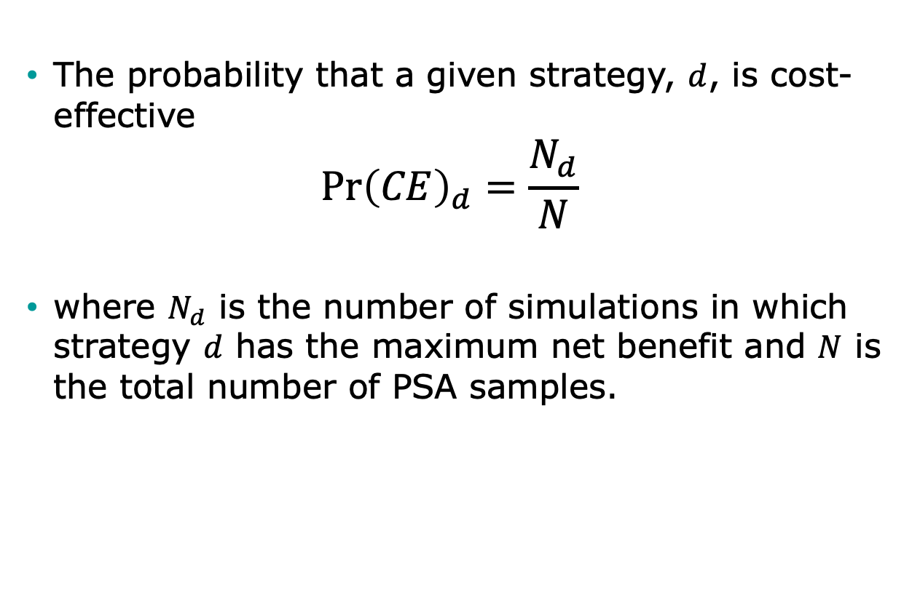
Decision Uncertainty
The probability that a given strategy, $d$, is cost-effective
$$\operatorname{Pr}{{\left(CE\right)}_{d}=\frac{N_{d}}{N}}$$
where $N_{d}$ is the number of simulations in which strategy $d$ has the maximum net benefit and $N$ is the total number of PSA samples.

Slide 35
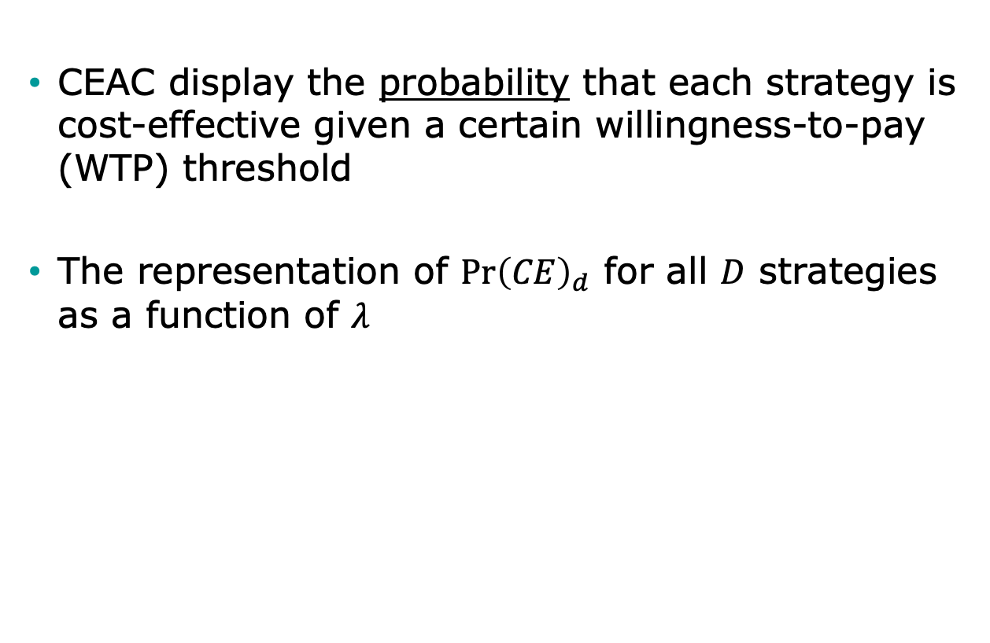
Cost-Effectiveness Acceptability Curves (CEAC)
CEAC display the probability that each strategy is cost-effective given a certain willingness-to-pay (WTP) threshold
The representation of $\operatorname{Pr}{{\left(CE\right)}_{d}}$ for all $D$ strategies as a function of $λ$

Slide 36


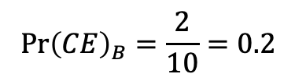
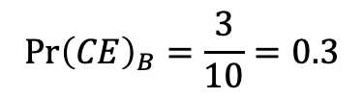

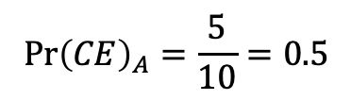

Construction of CEAC
$$N_{A}=5;$$
$$N_{B}=3;$$
$$N_{C}=2$$
$$N=10$$
$$\operatorname{Pr}{{\left(CE\right)}_{A}}=\frac{5}{10}=0.5$$
$$\operatorname{Pr}{{\left(CE\right)}_{B}}=\frac{3}{10}=0.3$$
$$\operatorname{Pr}{{\left(CE\right)}_{B}}=\frac{2}{10}=0.2$$
Highest probability

Slide 37
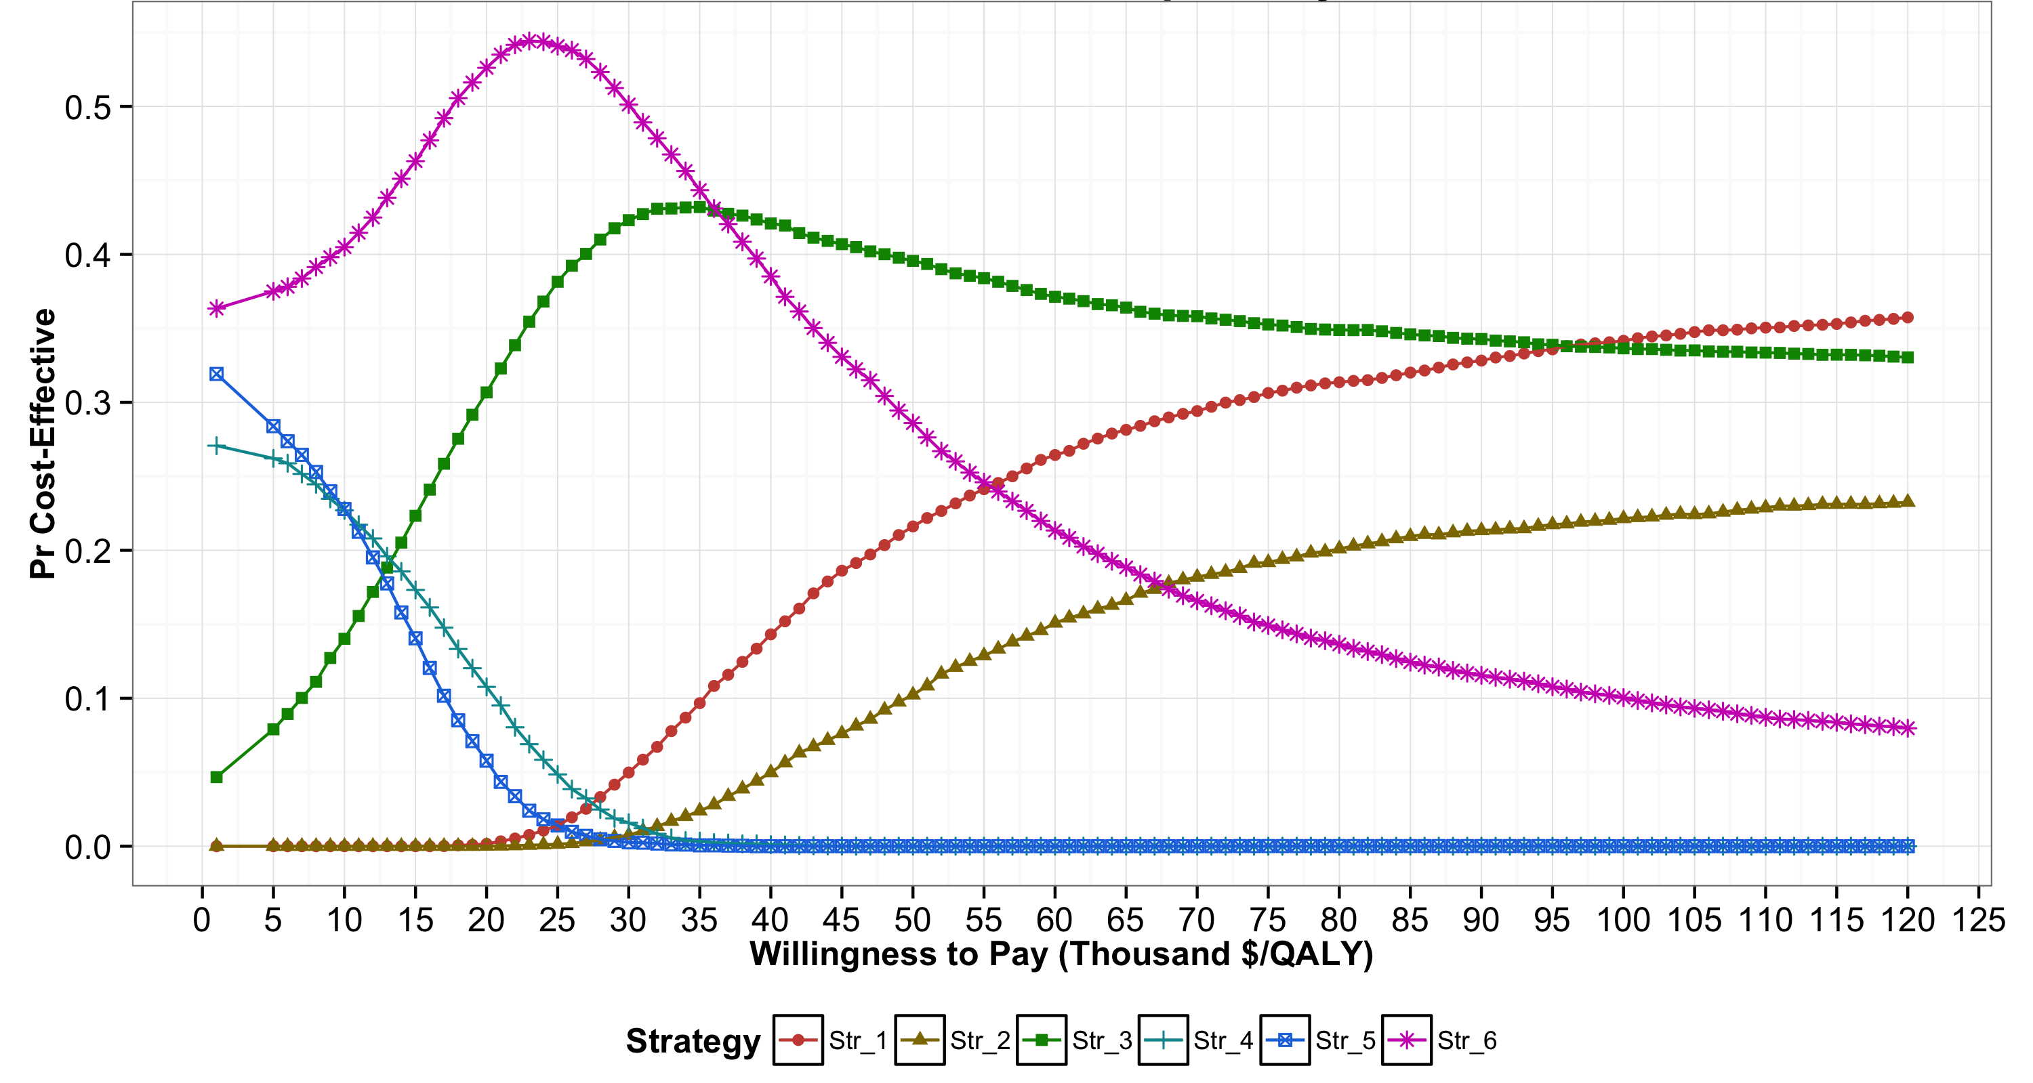
Cost-effectiveness acceptability curves (CEACs)

Slide 38
Cost-effectiveness acceptability curves (CEACs)

Slide 39
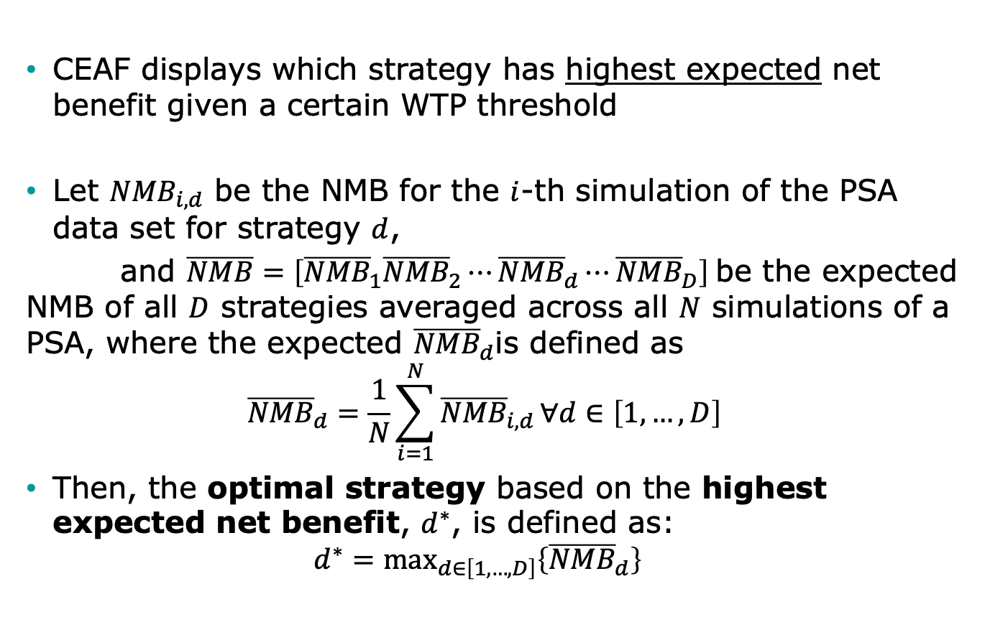
Cost-Effectiveness Acceptability Frontier (CEAF)
CEAF displays which strategy has highest expected net benefit given a certain WTP threshold
Let ${NMB}_{i,d}$ be the NMB for the $i$-th simulation of the PSA data set for strategy $d$,
and $\overline{NMB}=\left[{\overline{NMB}}_{1}{\overline{NMB}}_{2}⋯{\overline{NMB}}_{d}⋯{\overline{NMB}}_{D}\right]$be the expected NMB of all $D$ strategies averaged across all $N$ simulations of a PSA, where the expected ${\overline{NMB}}_{d}$is defined as
$${\overline{NMB}}_{d}=\frac{1}{N}\sum_{i=1}^{N}{{\overline{NMB}}_{i,d}}∀d∈\left[1,…,D\right]$$
Then, the optimal strategy based on the highest expected net benefit, $d^{∗}$, is defined as:
$$d^{∗}={\text{max}}_{d∈\left[1,…,D\right]}\left\{{\overline{NMB}}_{d}\right\}$$

Slide 40
Construction of CEAF
Highest expected net benefit = Optimal strategy

Slide 41
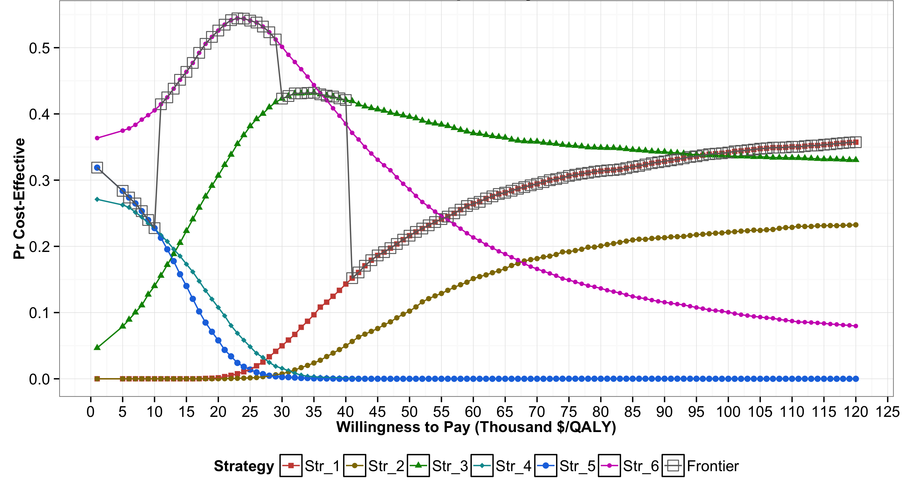
Cost-effectiveness acceptability curves (CEACs) and frontier (CEAF)

Slide 42
Cost-effectiveness acceptability curves (CEACs) and frontier (CEAF)

Slide 43
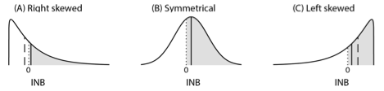
Distributions of Incremental NMB
Notes:
﻿The shaded area represents the probability of X being cost- effective compared to Y, which is the area under the curve to the right of INB = 0. The solid vertical line represents the expected INB of X vs. Y, and the dashed vertical line represents the median of the distribution of INB. X is optimal in all scenarios, but has the highest probability of being cost-effective only in scenarios B and C. In scenario B (i.e., symmetrical), the median and mean of INB coincide with each other.

Slide 44
Limitations of CEACs
Only provide certain level of comfort in a decision but do not influence decision making
Not actual influence on policy recommendation
Could be misleading -> ﻿the strategy that is most likely to be cost-effective should not be conflated with the strategy that is optimal in expectation in the decision-making process

Slide 45
Limitations of CEACs and CEAF
Neither ﻿capture the magnitude of the net benefit lost in the proportion of PSA samples when chosen strategy is not cost-effective
﻿The expected loss in net benefits is truly the concern of the decision-maker because this represents the foregone benefits resulting from having chosen a given strategy
﻿Do not communicate the ordinal information in the ranking of the strategies by their expected benefits
  Useful when implementing the optimal strategy is not feasible.

